Slide 1
Carvana Image Masking Challenge: Implementing a U-net
Jiawei Yu
Feb. 22, 2019
Kaggle task link:
https://www.kaggle.com/c/carvana-image-masking-challenge

Slide 2
Outline
Task overview
U-net
Data preprocessing & generation
Implementing & tweaking a U-net
Data augmentation
Results analyses & visualization

Slide 3
1.
Task Overview
Training/testing data visualization, train/val/test split plan.

Slide 4
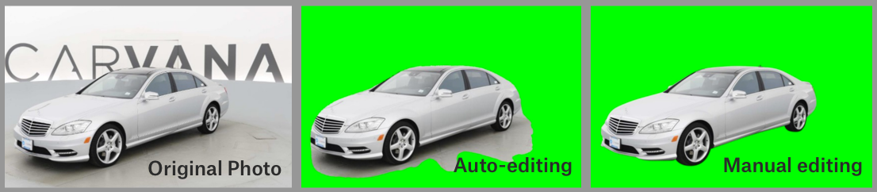
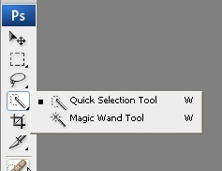
Develop an algorithm that automatically removes the photo studio background

Slide 5
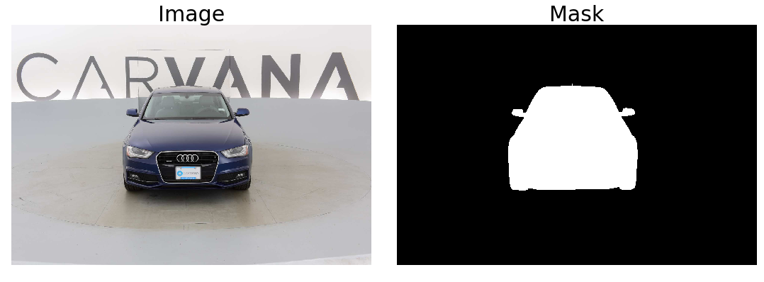
Training data
Image information
JPG format
RGB mode (3 channels)
‘uint8’ data ranging from 0 to 255
Size of 1918 × 1280 pixels
Mask information
GIF format
INDEX mode (1 channel)
‘uint8’ data with 0 and 1.
Size of 1918 × 1280 pixels

Slide 6
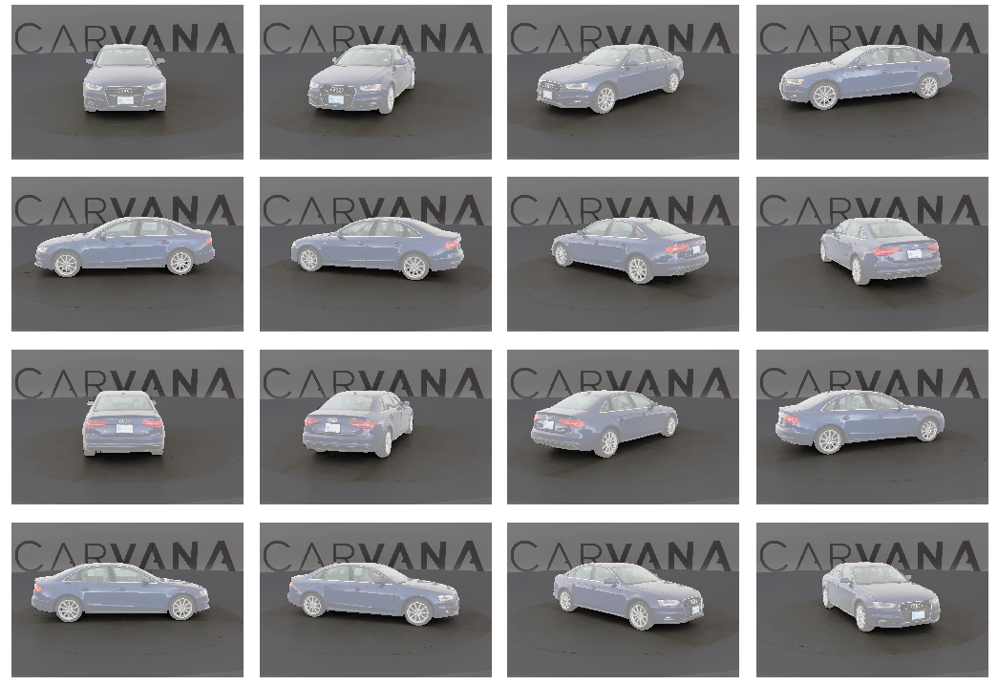
Train data w label (mask)
Total 5088 images/masks.
318 unique cars, each has 16 images taken from 16 different angles.
Test data w/o label
Total 100064 images/masks.
6254 unique cars, each has 16 images taken from 16 different angles.

Slide 7

Train data w label (mask)
Total 5088 images/masks.
318 unique cars, each has 16 images taken from 16 different angles.
Data leakage alert! Images of a same car with different angles should NOT be split into different pools (train/validation/test)
Train
Val
Test
190 cars
64
64
3040 images
1024
1024

Slide 8
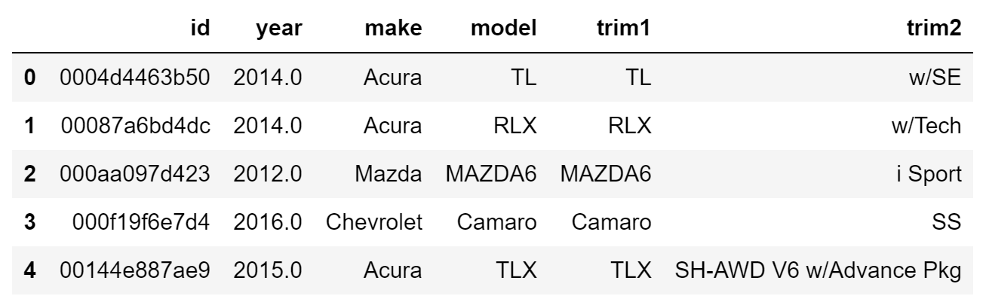
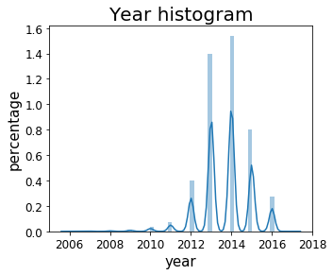
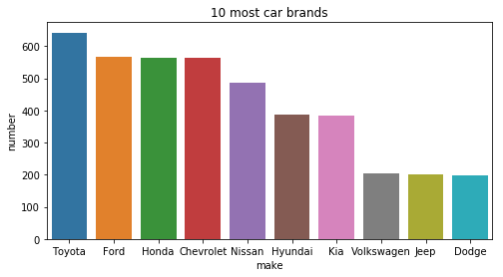
Meta data

Slide 9
2.
U-net
Powerful end-to-end CNN used for image segmentation

Slide 10
U-net architecture
3
8
16
8
2
1
512
512
16
32
16
256
256
32
64
32
128
128
64
128
64
64
64
128
Conv 3X3, ReLU
32
Conv 1X1, Sigmoid
Copy and concatenate
Dropout
Max pool 2X2
Up2 + Conv 2x2
Reference: Olaf et al., arXiv:1505.04597

Slide 11
3.
Data preprocessing & generation
Image resize, train/val/test split and data generator

Slide 12
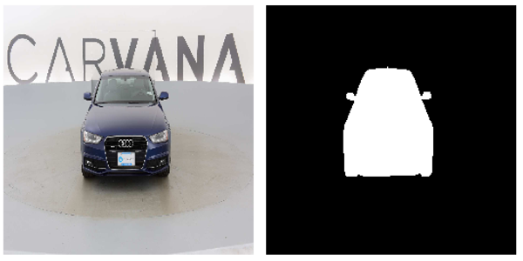
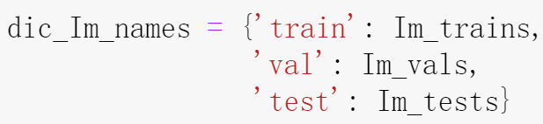
Resize the image & train/val/test split
Contains all unique car names as a list.

Slide 13
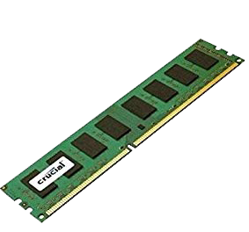
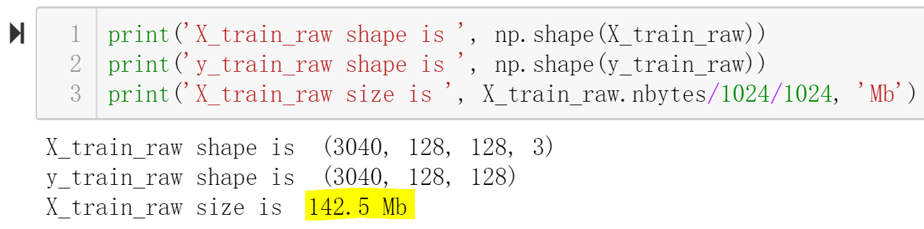
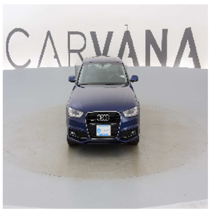
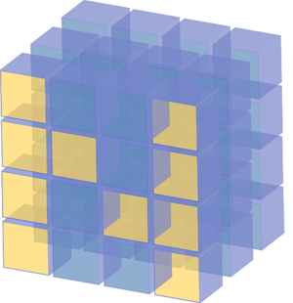
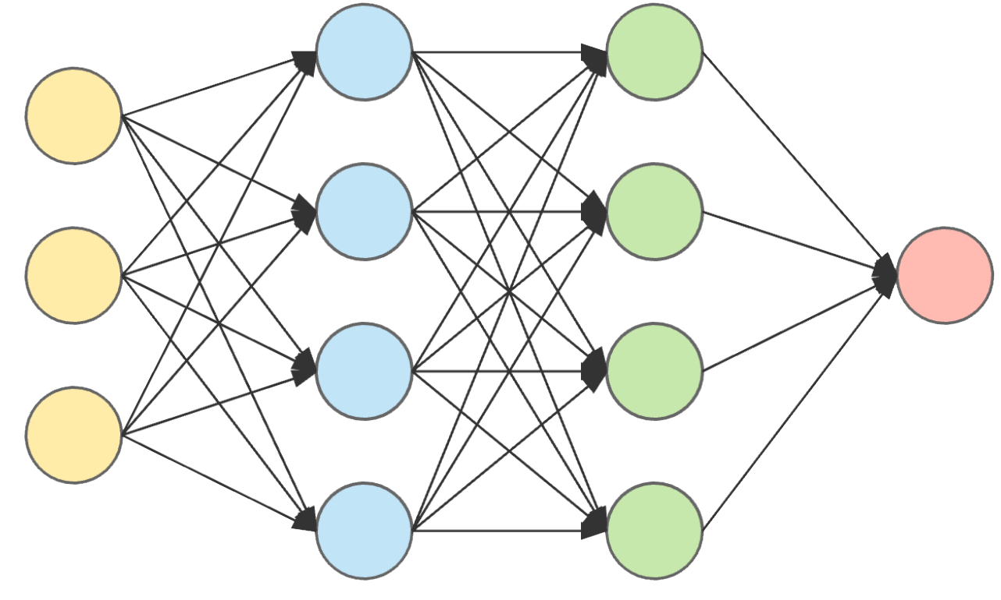
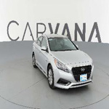
Data generator
Large data size: use a data generator to grab and train the batch on the fly.
1 batch
Image path

Slide 14
4.
Implementing & tweaking a U-net
Tackling input size & neural network hyperparameters

Slide 15
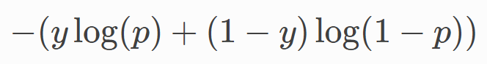
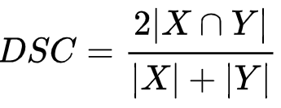
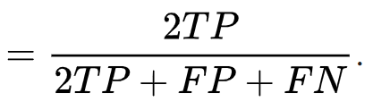
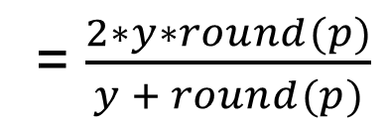
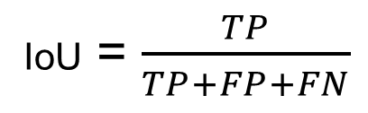
Loss function & metrics
Loss function:
Binary cross entropy =
Evaluation metric:
dice coefficient
Predict
1
Real
1
= $\frac{2∗y∗round(p)}{y + round(p)}$
FP
TP
FN
IoU = $\frac{TP}{TP+FP+FN}$

Slide 16
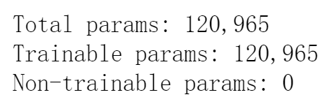
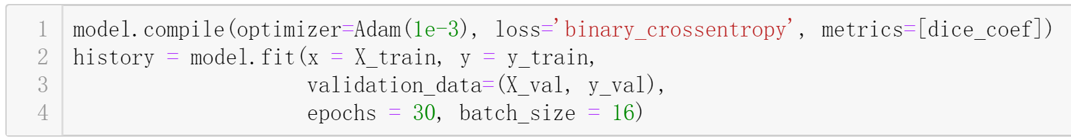
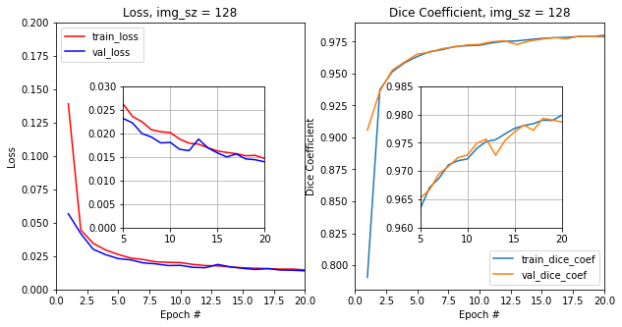
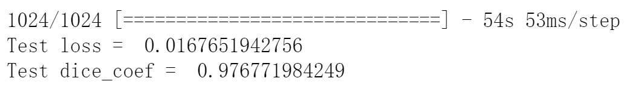
Compile and train the model

Slide 17
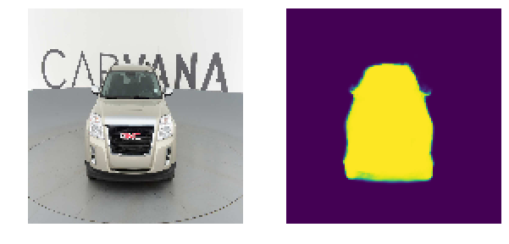
Make a prediction

Slide 18
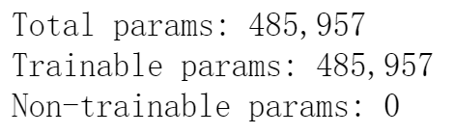
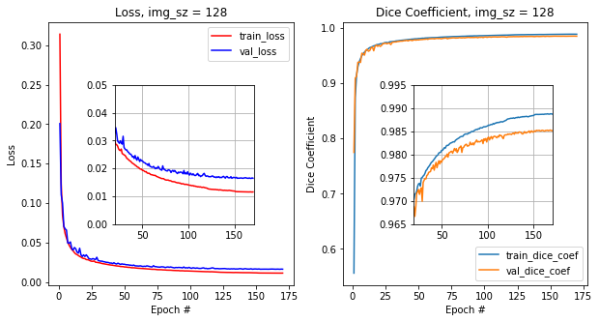
Use a larger U-net

Slide 19
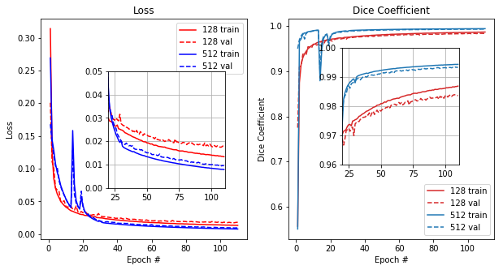
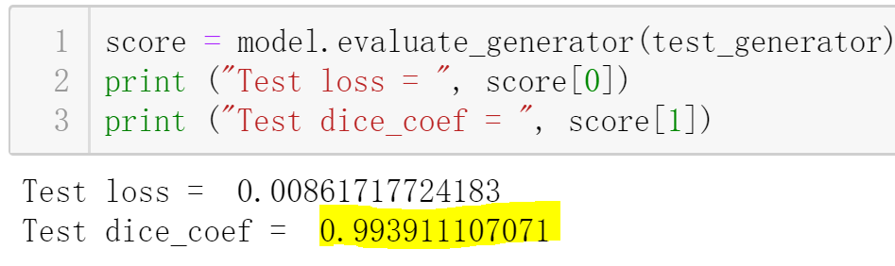
Increase the image size
Image size = 512

Slide 20
5.
Data augmentation
Generate more training data to train a larger U-net

Slide 21
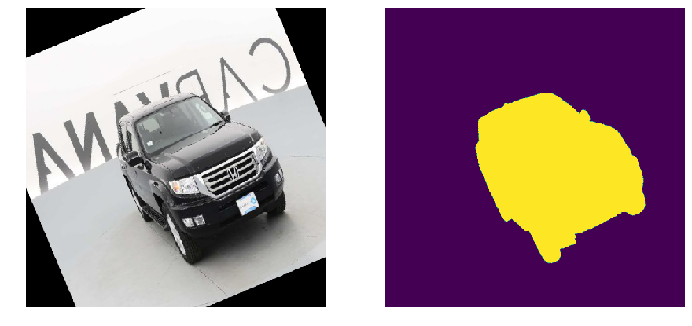
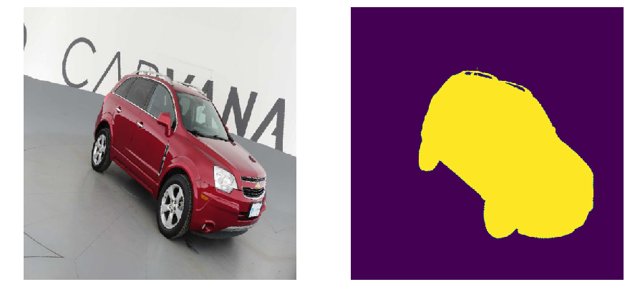
Random rotation & horizontal flip
Random rotation
(<25 degree)
50% chance to be flipped horizontally.
Set mode=‘symmetric’ to eliminate the black triangles.

Slide 22
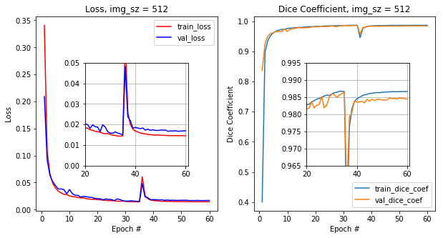
Performance drops after implementing augmentation, indicating that model with data augmentation underfits the data.

Slide 23
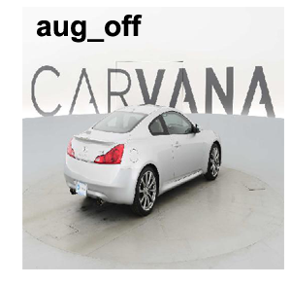
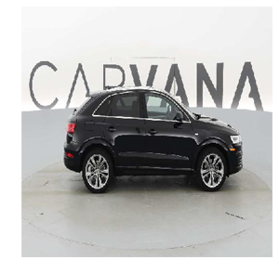
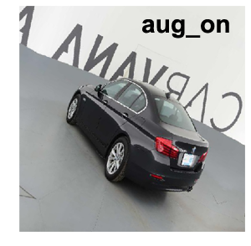
train
test
Training images w/o augmentation share the same studio background with that of the test images. It will be easier for nn to learn these simple features and make a better prediction.
Possible solution: use batch norm to reduce the “covariance” of different layers in nn.

Slide 24
6.
Results analyses & visualization
Model evaluation, results analyses and feature map visualization

Slide 25
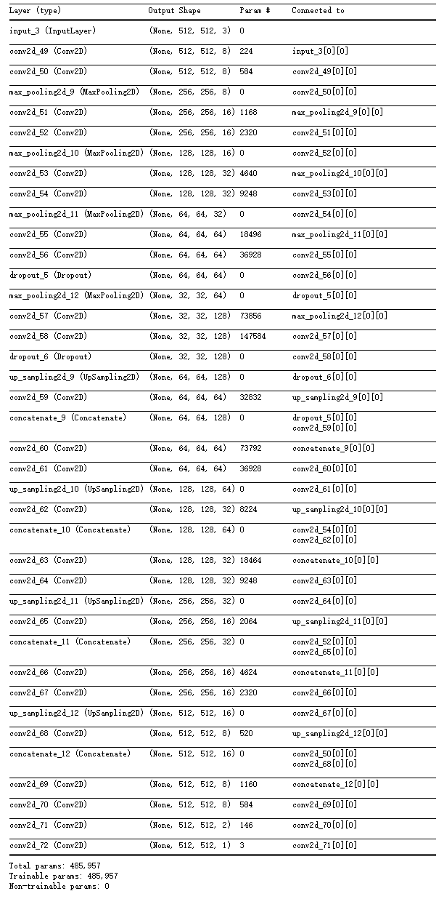
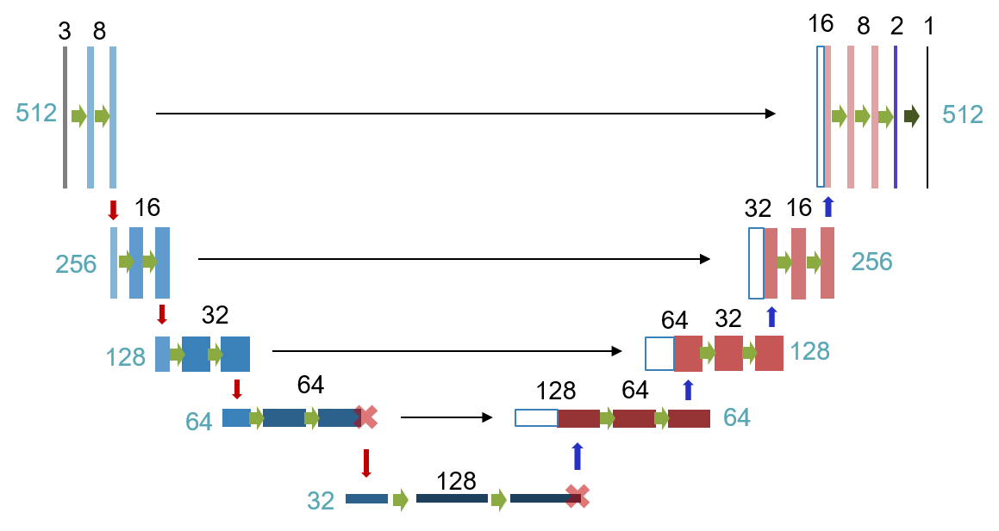
Model summary

Slide 26
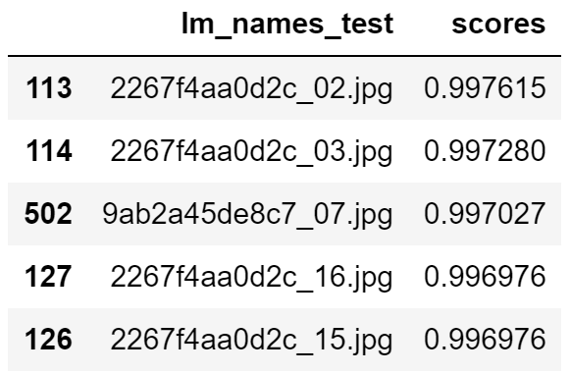
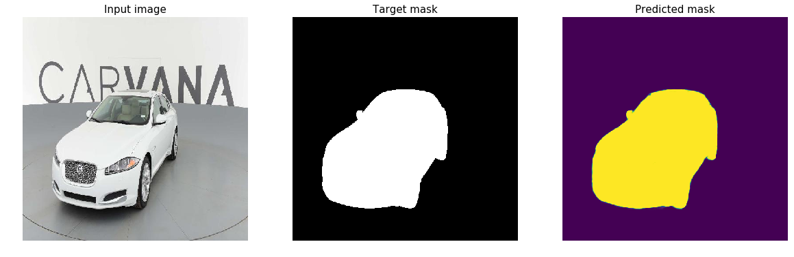
Model evaluation: Good predictions

Slide 27
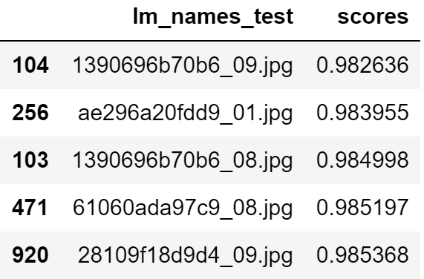
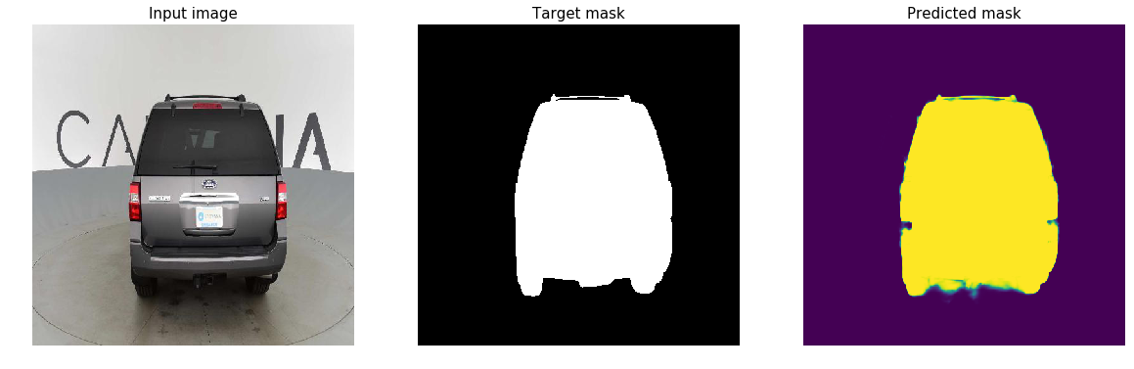
Bad predictions

Slide 28
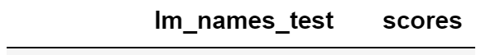
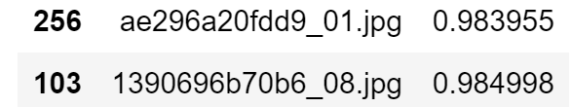
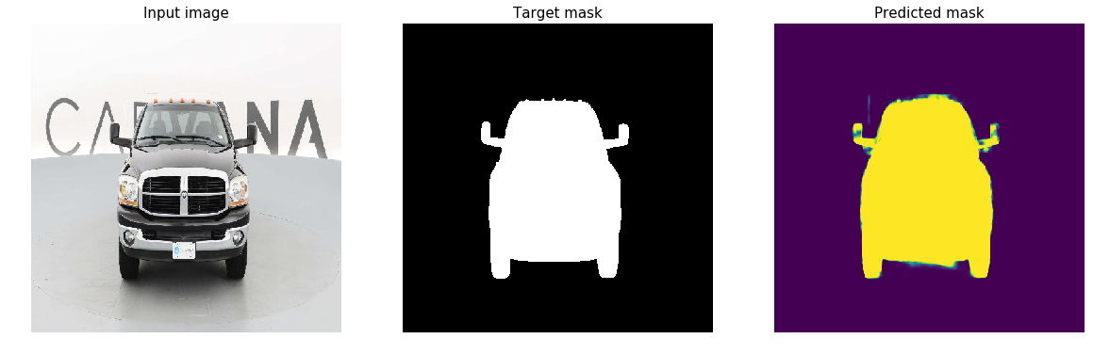
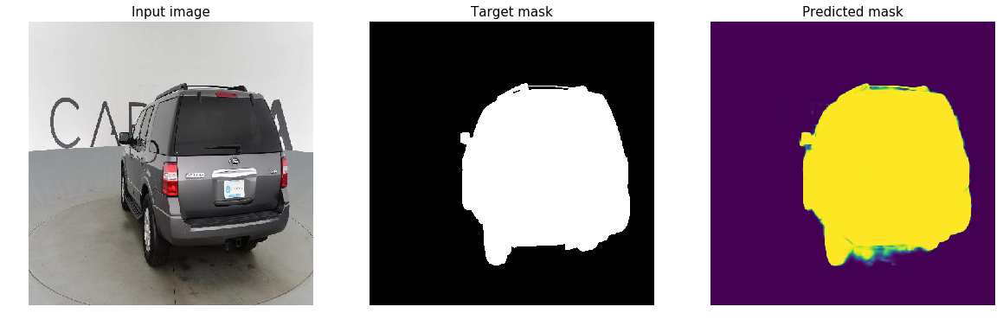

Slide 29
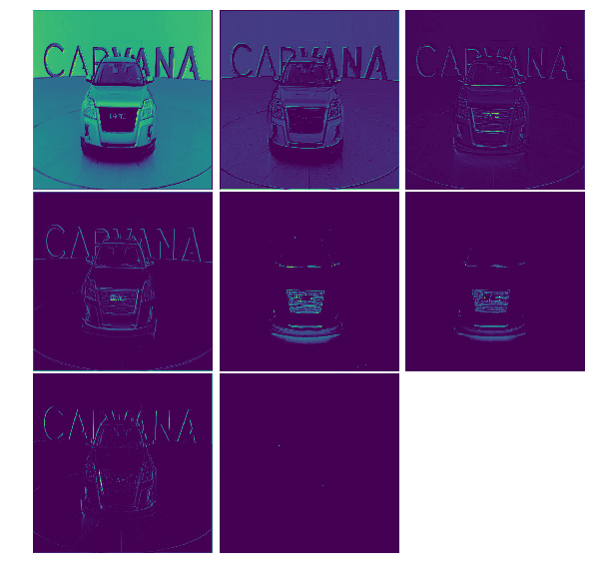
Visualization of Feature map

Slide 30
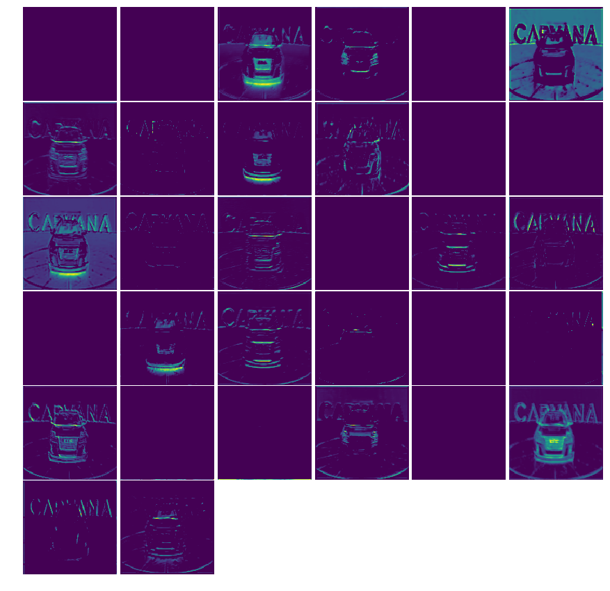

Slide 31
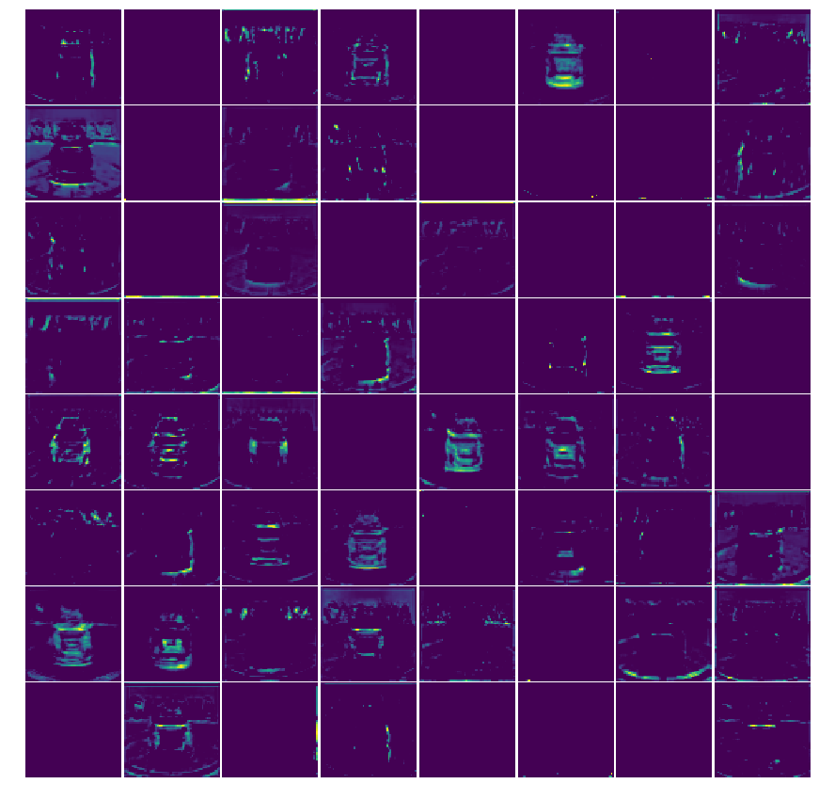

Slide 32
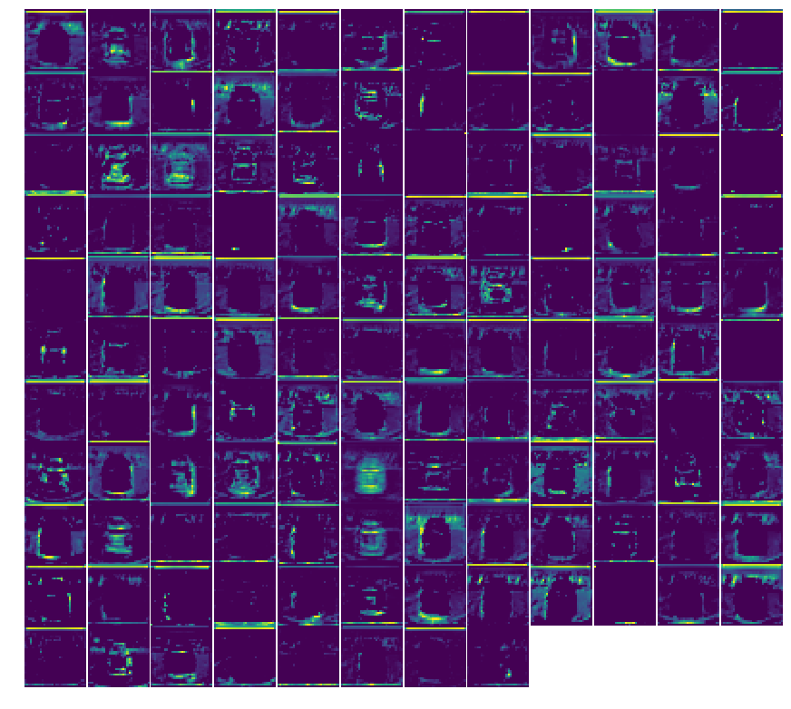

Slide 33
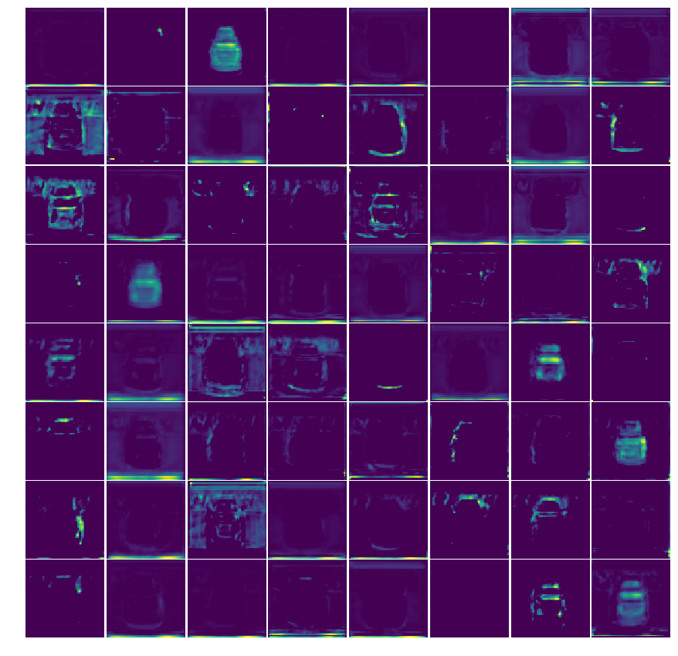

Slide 34


Slide 35


And finally…a prediction!

Slide 36
Here is what I learnt…
U-net
A powerful CNN architecture for semantic segmentation tasks.
Data Generator
Train NN on the fly. Practiced OOP.
Keras
Awesome API to implement CNN in a few lines of codes.
Data Augmentation
Generate enormous data to train a large NN.
Visualization
Plot results for a better analyse and evaluation.
Feature map
"Look into” the deep NN and see what it is learning.

Slide 37
Thanks!
😉
Any questions?

Slide 38
Appendix
Some useful stuff..

Slide 39

Upsampling: interpolation
https://www.cs.toronto.edu/~guerzhoy/320/lec/upsampling.pdf

Slide 40


Transposed convolution
Trans Conv
Conv
Source: https://towardsdatascience.com/up-sampling-with-transposed-convolution-9ae4f2df52d0

Slide 41

Transposed convolution

